Slide 1

Topics
•
Vector
class
in
Java
1
Object-Oriented Programming Using Java

Slide 2
Vector class in Java
•
•
Vector class supports growable array of objects.
Two Types of Vectors : Parameterized (Can Hold Values of
only one Type)
Various Types)
Constructors
Vector() Vector<T>()
and Un-parameterized( can
Hold
Values
of
•
❑
[Un-parameterized],
[Parameterized]
= 10 , increment = 2*capacity
[Un-parameterized],
[Parameterized]
= size, increment = 2*capacity
size() = 0 , capacity
Vector(int size) Vector<T>(int size) size() = 0 , capacity
❑
❑
Vector(int size, int incr) [Unparameterized],
Vector<T>(int size, int incr) [Parameterized]
size() =0, capacity = size, increment = incr
2
Object-Oriented Programming Using Java

Slide 3
Vector vs Array
1.
Array
holds
elements
of
only
one
type.
Vector
can
hold
elements of various types [However, parameterized vectors are
preferred]
2.
Array
elements
are
referred
via subscripts such
as data[0],
marks[2][3]. Vector
elements
are also indexed but are
manipulated via add(..), get(..), set(..) methods. For example,
suppose ‘v’ is a vector instance, then v.get(0) returns element
stored at index 0.
Array can be 1-D, 2-D etc. However there is no dimension in
Vector.
3.
4.
Arrays
have
<<length>>
as an
attribute.
Vector uses
size()
method to get its current size .
5.
ArrayIndexOutofBoundsException (if an element is referred out of array index) occurs in Arrays. In Vector the corresponding exception is IndexOutofBoundsException.
3
Object-Oriented Programming Using Java

Slide 4
Important Methods of Vector
class
•
•
•
•
•
int size() → Returns the size of Vector
int capacity() → Returns the capcity of Vector
boolean add(E e) → Adds ‘e’ of type ‘E’ at end of vector [Parameterized]
boolean add(Object o) → Adds ‘o’ of type Object at end of vector [Un-Parameterized]
boolean add(int index, E e) → Adds ‘e’ of type ‘E’ at a specified index (0<=index<=size-of-vector) [Parameterized]
Boolean add(int index, Object o) → Adds ‘o’ of type ‘Object’ at a specified index (0<=index<=size-of-vector) [Un-Parameterized]
boolean addAll(Collection c) → Adds the elements of collection ‘c’ at the end of the invoking collection
boolean addAll(int index, Collection c) → Adds the elements of collection c in the current vector starting from
index
E get(int index) → Returns the element of type ‘E’ from index. Throws IndexOutofBoundsException if index
>= size. [Parameterized]
•
•
•
•
•
Object
get(int
index)
→
Returns
the
element
of type
‘Object’
from
index.
Throws
IndexOutofBoundsException if index >= size. [Un-Parameterized]
void clear() → Removes all the elements and sets size = 0
void remove (int index) → Removes an elements from index (0<=index<size)
void remove (Object o) → Removes the first occurrence of ‘o’ if exists otherwise no effect
void insertElement(int index, Object o) → Inserts an element ‘o’ at index (0<=index<size).
void set(int index, E e) → Sets the element at index via element ‘e’ [Update/modify the previous value]
•
•
•
•
•
4
Object-Oriented Programming Using Java

Slide 5
Vector class : Example
1
….
import java.util.*;
To use Vector class
class VectorDemo
{
public static void main(String args[])
{
Vector v1 = new Vector(5); System.out.println(v1.size()); System.out.println(v1.capacity());
Un-parameterized Vector
0
5
v1.add(10);
Adds 10 (int) at index 0
Adds 20.5 (double) at index 1
Adds 3.6f (float) at
Adds “Object” (String)
v1.add(20.5);
v1.add(3.6f);
index 2
v1.add(“Object”);
at index 3
Adds 5 (int) at index 4
Adds 6 (int) at index 5
6
10
v1.add(5);
v1.add(6);
System.out.println(v1.size());
System.out.println(v1.capacity());
}// End of Method
}// End of VectorDemo class
5
Object-Oriented Programming Using Java

Slide 6
Vector class : Example 1
•
If you are using an Un-parameterized Vectors in your
program then you have
<<–Xlint>> option
to compile the program using
•
Syntax : javac
-Xlint
name-of-source-file
Error if compiled w/o –Xlint
F:\>javac VectorDemo.java
Note: VectorDemo.java uses unchecked or unsafe operations.
Note: Recompile with -Xlint:unchecked for details.
6
Object-Oriented Programming Using Java

Slide 7
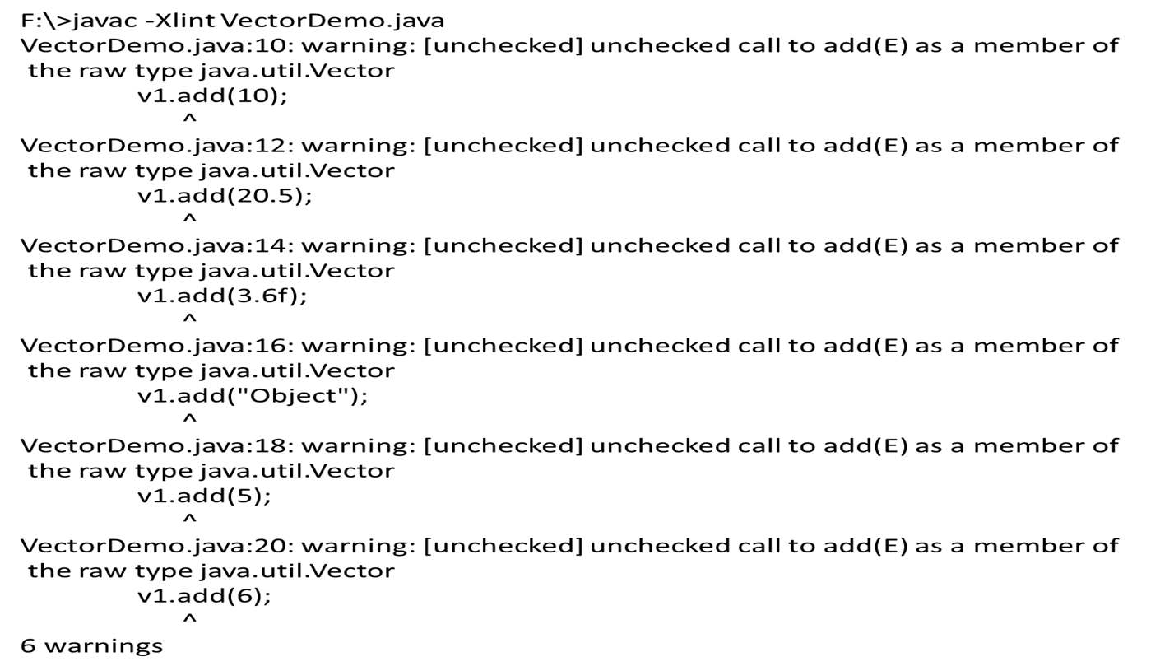
Vector class : Example 1 ….
•
Compiling with
–Xlint
option
will
results
in
warnings
not
errors.
<<OUTPUT>>
F:\>java VectorDemo
0
5
6
10
7
Object-Oriented Programming Using Java

Slide 8
Some Facts About Un-
parameterized Vectors
•
•
•
Elements of any type are added and retrieved only in ‘Object’ type.
You have to type cast the element to its base type before use.
Example :
Sum
of
numbers
stored
in
vector
import java.util.*;
class VectorDemo
{
public static void main(String args[])
{
Vector v1 = new Vector(5);
F:\>javac -Xlint VectorDemo.java
VectorDemo.java:8: warning: [unchecked] unchecked call to
add(E) as a member of
the raw type java.util.Vector
v1.add(10); v1.add(20); v1.add(30);
^
VectorDemo.java:8: warning: [unchecked] unchecked call to
add(E) as a member of
the raw type java.util.Vector
v1.add(10); v1.add(20); v1.add(30);
^
VectorDemo.java:8: warning: [unchecked] unchecked call to
add(E) as a member of
the raw type java.util.Vector
v1.add(10); v1.add(20); v1.add(30);
^
VectorDemo.java:12: operator + cannot be applied to
double,java.lang.Object
sum = sum + v1.get(i);
^
1 error
3 warnings
v1.add(10); v1.add(20); v1.add(30);
double sum = 0;
for(int i =0; i < v1.size(); i++)
sum = sum + v1.get(i);
}// End of Method
}// End of VectorDemo class
8
Object-Oriented Programming Using Java

Slide 9
Some Facts About Un-
parameterized Vectors ….
import java.util.*;
class VectorDemo
{
public static void main(String args[])
{
Vector v1 = new Vector(5);
F:\>javac -Xlint VectorDemo.java
VectorDemo.java:8: warning: [unchecked] unchecked
call to add(E) as a member of
the raw type java.util.Vector
v1.add(10); v1.add(20); v1.add(30);
^
VectorDemo.java:8: warning: [unchecked] unchecked
call to add(E) as a member of
the raw type java.util.Vector
v1.add(10); v1.add(20); v1.add(30);
^
VectorDemo.java:8: warning: [unchecked] unchecked
call to add(E) as a member of
the raw type java.util.Vector
v1.add(10); v1.add(20); v1.add(30);
^
3 warnings
v1.add(10); v1.add(20); v1.add(30);
double sum = 0;
for(int i =0; i < v1.size(); i++)
sum = sum + (Integer) v1.get(i);
System.out.println(“Sum=“+sum);
}// End of Method
}// End of VectorDemo class
F:\>java VectorDemo
Sum= 60.0
9
Object-Oriented Programming Using Java

Slide 10
Parameterized Vectors
•
•
•
Holds Elements of only One Type.
No need to compile using
<<-Xlint>> option
Compile-Time Error →if any other type element is being added
import java.util.*;
class VectorDemo
{
public static void main(String args[])
{
Parameterized Vector of String type
Vector<String> v1 = new Vector<String>(5);
v1.add("10");
v1.add(20);
v1.add(30);
//
//
//
Correct
Compile-Time Error
Compile-Time Error
F:\>javac VectorDemo.java
VectorDemo.java:9: cannot find symbol
symbol : method add(int)
location: class java.util.Vector<java.lang.String>
v1.add(20);
^
VectorDemo.java:10: cannot find symbol
symbol : method add(int)
location: class java.util.Vector<java.lang.String>
v1.add(30);
^
2 errors
}// End of Method
}// End of VectorDemo class
10
Object-Oriented Programming Using Java

Slide 11
Thank
You
11
Object-Oriented Programming Using Java

